Slide 1
Built-in and Scalar Function
(Developing and Design of databases using SQL Server)
Trainer – Panche Manaskov
Assistant – Aleksandar Milovski

Slide 2
AGENDA
Programming Concepts
Built-In functions
Scalar functions

Slide 3

PROGRAMMING CONCEPTS

Slide 4
DECLARATIONS
Scalar variable: DECLARE @EmployeeId INT SET @EmployeeId = 1
Table variable: DECLARE @EmployeeList TABLE (EmployeeId int, FirstName NVARCHAR(100), LastName NVARCHAR(100));
INSERT INTO @EmployeeList SELECT Id, FirstName, LastName from dbo.Employee
Temp table: CREATE TABLE #EmployeeList (EmployeeId int, FirstName NVARCHAR(100), LastName NVARCHAR(100));
INSERT INTO #EmployeeList SELECT Id, FirstName, LastName from dbo.Employee

Slide 5
FLOW OF CONTROL
DECLARE @name NVARCHAR(255);
SET @name = 'Bob';
IF(LEN(@name) < 2 )
SELECT 'Too short name';
ELSE
SELECT @name + ' is a suitable name.' AS [Name Check Result];

Slide 6

BUILT-IN FUNCTIONS

Slide 7
BUILT-IN FUNCTIONS
LEFT(), RIGHT(), LEN()
SUBSTRING
SUBSTRING ( expression ,start , length )
REPLACE
REPLACE ( string_expression , string_pattern , string_replacement )
SELECT FirstName,
LEFT(FirstName,3) AS LeftFunction,
RIGHT(FirstName,3) AS RightFunction,
LEN(FirstName) AS LenFunction,
SUBSTRING(FirstName,1,3) AS SubstringFunction,
REPLACE(FirstName,'Ale','X-') AS ReplaceFunction
FROM dbo.Employee

Slide 8
WORKSHOP 01
Declare scalar variable for storing FirstName values
Assign value ‘Aleksandar’ to the FirstName variable
Find all Employees having FirstName same as the variable
Declare table variable that will contain EmployeeId and DateOfBirth
Fill the table variable with all Female employees
Declare temp table that will contain LastName and HireDate columns
Fill the temp table with all Male employees having First Name starting with ‘A’
Retrieve the employees from the table which last name is with 7 characters

Slide 9

SCALAR FUNCTIONS

Slide 10
SCALAR FUNCTIONS
User-defined functions are routines that accept parameters, perform an action, such as a complex calculation, and return the result of that action as a value.
Scalar functions allow modular programming.
Scalar functions return a single data value of the type defined in the RETURNS clause

Slide 11
SCALAR FUNCTIONS - EXAMPLE
Session 4 – 01 Scalar function.sql
CREATE FUNCTION dbo.fn_EmployeeFullName (@EmployeeID int)
RETURNS NVARCHAR(2000)
AS
BEGIN
DECLARE @Result NVARCHAR(2000)
SELECT @Result = e.FirstName + N' ' + e.LastName
FROM dbo.Employee e
WHERE Id = @EmployeeID
RETURN @Result
END
SELECT dbo.fn_EmployeeFullName(1) /* CALLING A SCALAR FUNCTION */

Slide 12
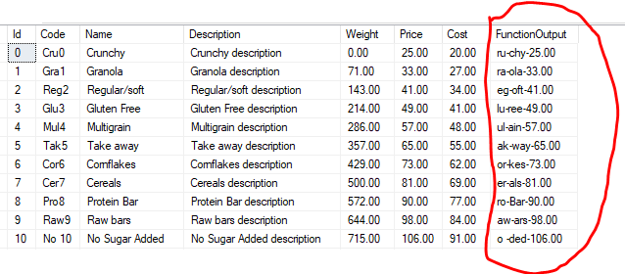
WORKSHOP 02
Declare scalar function (fn_FormatProductName) for retrieving the Product description for specific ProductId in the following format:
Second and Third character from the Code
Last three characters from the Name
Product Price

Slide 13

HOMEWORK

Slide 14
HOMEWORK REQUIREMENTS
Declare scalar variable for storing FirstName values
Assign value ‘Antonio’ to the FirstName variable
Find all Students having FirstName same as the variable
Declare table variable that will contain StudentId, StudentName and DateOfBirth
Fill the table variable with all Female students
Declare temp table that will contain LastName and EnrolledDate columns
Fill the temp table with all Male students having First Name starting with ‘A’
Retrieve the students from the table which last name is with 7 characters
Find all teachers whose FirstName length is less than 5 and
the first 3 characters of their FirstName and LastName are the same

Slide 15
QUESTIONS?
You can find us at
panemanaskov!@gmail.com
aleksandarmilovski1@gmail.com
You can find the code at

